Slide 1






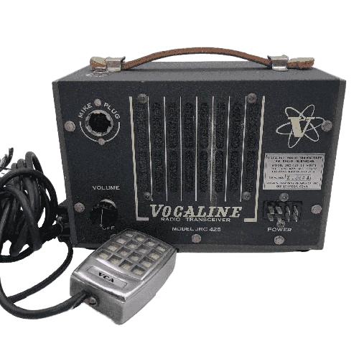


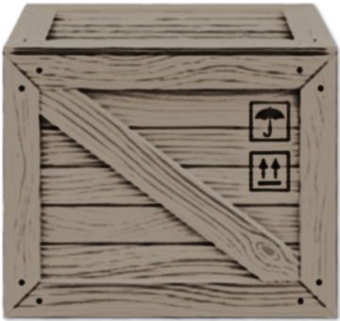






Trapped in a storm, your mind is the only way out
Stuck in a log cabin in the middle of a snowstorm, it's up to you to coordinate with your team and escape together.
Key Mechanics:
Walk and interact with a large variety of objects around the house
Gather information and pictures around the house and organize them in a cork board;
Use a transceiver radio to talk to your friends and help them;
Game Specs:
1st Person View
3D Style; Single Player;
Escape room;
For PC only.
Alexandre Teixeira André Sebastião Daniela Peixoto Rodrigo Pires Vitor Daniel

